Slide 1
http://filebox.vt.edu/users/ateller/portfolio/ncss/lp/ncss4.pdf

Slide 2
Please complete only PART 1 of the worksheet.
While completing the worksheet think about who you believe you
are as a person and how you came to feel this way about yourself.

Slide 3
OBJECTIVES FOR TODAY
1) Erikson’s theory of psychosocial development as it relates to Identity Formation.
2) Erikson’s three factors that influence identity formation.
3) The major issue surrounding Erikson’s theory of identity formation.
4) Your own thoughts on identity formation.

Slide 4
Erikson’s Theory of Psychosocial Development (Review)
Erikson’s theory consists of 8 stages. Within each stage a crisis must be resolved.
This crisis is a major developmental issue that becomes important during a specific time period throughout one’s life.
 In order to be successful at solving this crisis, one must balance positive and a corresponding negative trait.
(see next slide for chart)

Slide 5
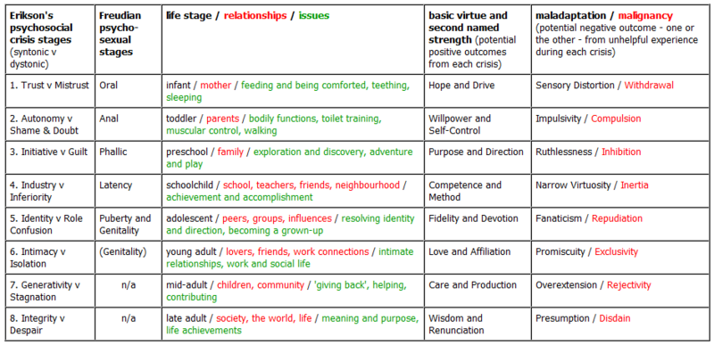

Slide 6
Erikson’s Theory of Psychosocial Development Continued…
In most situations the positive traits prevail. However, Erikson did believe that negative traits are needed as well.
 Example: In infancy, the crisis is trust vs. mistrust. People need to learn to trust the world around them but in order to do this, they also need to learn about mistrust to protect themselves from danger.

Slide 7
Erikson’s theory on identity formation…
Stage 5 of Erikson’s theory is identity formation, which begins in adolescence.
The crisis in this stage is known as identity vs. identity confusion which is also known as role confusion.
 During this stage adolescents are attempting to make sense of who they are and what their valued role is in society.

Slide 8
Note Card Activity
Take a look at your note card and the factor it states on it.
1) Think about the factor on your note card.
2) Answer the questions in Part 2 of your worksheet.
3) When you finish, begin thinking about how your thoughts were changed from. Part 1 to Part 2.

Slide 9
Discussion Guide
What types of changes influenced you the most?—write on board
Compared part 1 & 2 of worksheet, how are they different? How did they influence you?
Looking at the list of events on the board, do these events look minor or major life events?
What aspects of your life do these events relate to? Are there a variety of situations you see?
Do you believe outside forces effect identity formation? Why would this be the case?

Slide 10
Erikson’s Theory on Identity Formation Continued…
Identity is NOT formed by mimicking others.
It is formed by taking early assumptions about identity, modifying and synthesizing those ideas into a new structure.
 The resolution of three main areas is key to resolving conflicts in identity formation.
They are:
choice of occupation,
the adoption of values to live by and believe in
the development of a satisfying sexual identity.

Slide 11
Erikson’s Theory of Identity Formation Continued…
When the crisis in stage 5 is successfully resolved, it is known as fidelity. When this occurs, individuals have developed a sustained loyalty, faith, or a sense of belonging to a loved one or to friends. It can also mean identification with a certain set of values, religious group, political group, etc.

Slide 12
Factors that Influence Identity Formation…
There are multiple factors that can influence identity formation.
The first factor is gender since males and females form their identity through different ways.
Women form their identity through relationships while men do not.
This usually occurs since women tend to have lower self esteem than men.

Slide 13
Factors that Influence Identity Formation Continued…
The next factor is ethnicity.
Identity formation is extremely complicated for members of a minority group.
Physical features can greatly influence an individual’s self concept.
The final factor is sexual orientation.
Society makes it difficult for individuals with a sexual orientation that differs from the heterosexual norm.
Stereotypes and discrimination are huge factors here.

Slide 14
Potential Problem with Erikson’s Theory on Identity Formation…
 Erikson considered male identify formation to be the norm. He stated that women formed their identity through intimacy while men could not be involved in intimacy until after their identity had been fully formed.
This is why many disregard Erikson’s theory as the truth and simply use it to build upon.

Slide 15
Writing Assignment
Complete the following writing assignment.
Thinking about the activity and discussion we have had in class today… write a paragraph or two describing how much you believe life events influence identity formation.

