Slide 1
Psychology Chapter 4
Adolescence

Slide 2
Terms (pg 93)
Section 1 Objectives
Initiation rites
Puberty
Menarche
Spermarche
Asynchrony
Describe the physical changes that characterize adolescence
Describe research related to the sexual attitudes and roles of adolescence

Slide 3
Quiz pages 93-99
List 3 initiation rites or rites of passage in our culture.
List 3 developmental tasks that must be mastered in adolescence.
What event do must societies consider the beginning of womanhood?
T/F Boys who mature earlier are more likely to become leaders than boys who mature later.
T/F Girls who mature earlier are more likely to be proud of their self image in their early teens and then embarrassed of their body image in their late teens.
T/F Middle- and upper-class females in the U.S. who attend college are less sexually active than women in the U.S. 30-40 years ago.

Slide 4
Physical & Sexual Development
List of initiation rites that take place during adolescence
13th Birthday – moving into the teen years, Bar Mitzvah/Bat Mitzvah
16th Birthday
18th Birthday
High School Graduation
Going off to College
21st Birthday
pg 93-94

Slide 5
Theories of Adolescence
Psychologist | Description | Characteristics
Hall | Storm & Stress | Confused, troubled, highly frustrated
Mead | Time of Enjoyment | Growing, enjoying new challenges
pg 94-95

Slide 6
Havinghurst’s adolescent tasks that must be dealt with
Accepting one’s physical makeup and gender role
Developing appropriate relations with friends of both sexes
Becoming emotionally independent of parents and other adults
Achieving assurance of economic independence
Deciding on a vocation/career
Developing cognitive skills needed for social competence
Understanding and achieving socially responsible behavior
Preparing for marriage and family
Acquiring values that are harmonious and appropriate
pg 95

Slide 7
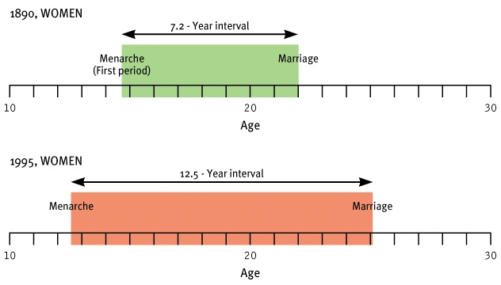
Is adolescence getting longer or shorter? Reaction to chart?

Slide 8
Physical Development & Reactions
BOYS
GIRLS
CHANGE
REACTION
EARLY MATURATION
CONFIDENT LEADER
EMBARASSED, GET INTO TROUBLE
LATE MATURATION
MAY W/DRAW & REBEL
MAY HAVE LOW SELF IMAGE
pg 96-98

Slide 9
Sexual Attitudes
18th Century – teens typically married earlier – pregnancy usually led to shot-gun wedding
19th Century – marriage still occurred early in life – pregnancy usually led to shot-gun wedding
pg 98-99

Slide 10
20th Century – early 20th century – marriage still occurred early in life – pregnancy usually led to shot-gun wedding
1950s – marriage was often postponed for college or vocational training
1960s – more teens were going to college and postponing marriage. Sexual Revolution, introduction of the pill – young women were more likely to engage in premarital sex since the protection could depend on them.
1970s – teens going to college and receiving training past high school greatly increased. Easily accessed birth control and abortions cut down on pregnancies, but premarital sex increased
1980s – AIDS and other STDs appear. Birth control and “Safe Sex” become more important
1990s – AIDS and other STDs begin to decline, but “Safe Sex” is still recommended and women become more openly sexually active as promiscuity is more accepted by society
21st Century – the future of monogamy appears to be dim.
END OF SECTION 1
pg 98-99

Slide 11
Terms Page 101
Section 2 Objectives
Rationalization
Identity crisis
Social learning theory
Describe the cognitive and ideological changes that characterize adolescence.
Outline the process by which adolescents find a personal identity.

Slide 12
Personal Development
Adolescents can understand hypothetical situations.
This leads to all kinds of realizations!
pg 101-102

Slide 13
COGNITIVE DEVELOPMENT
Eklind’s thoughts on it all…
Find Fault with Autonomy Figures | Grownups ain’t Perfect
Argumentativeness | Found their own opinions
Indecisiveness | Too many choices
Apparent hypocrisy | Have trouble understanding an ideal and living up to it
Self-consciousness | They think everyone is thinking about them
Invulnerableness | Invincibility
pg 101-103

Slide 14
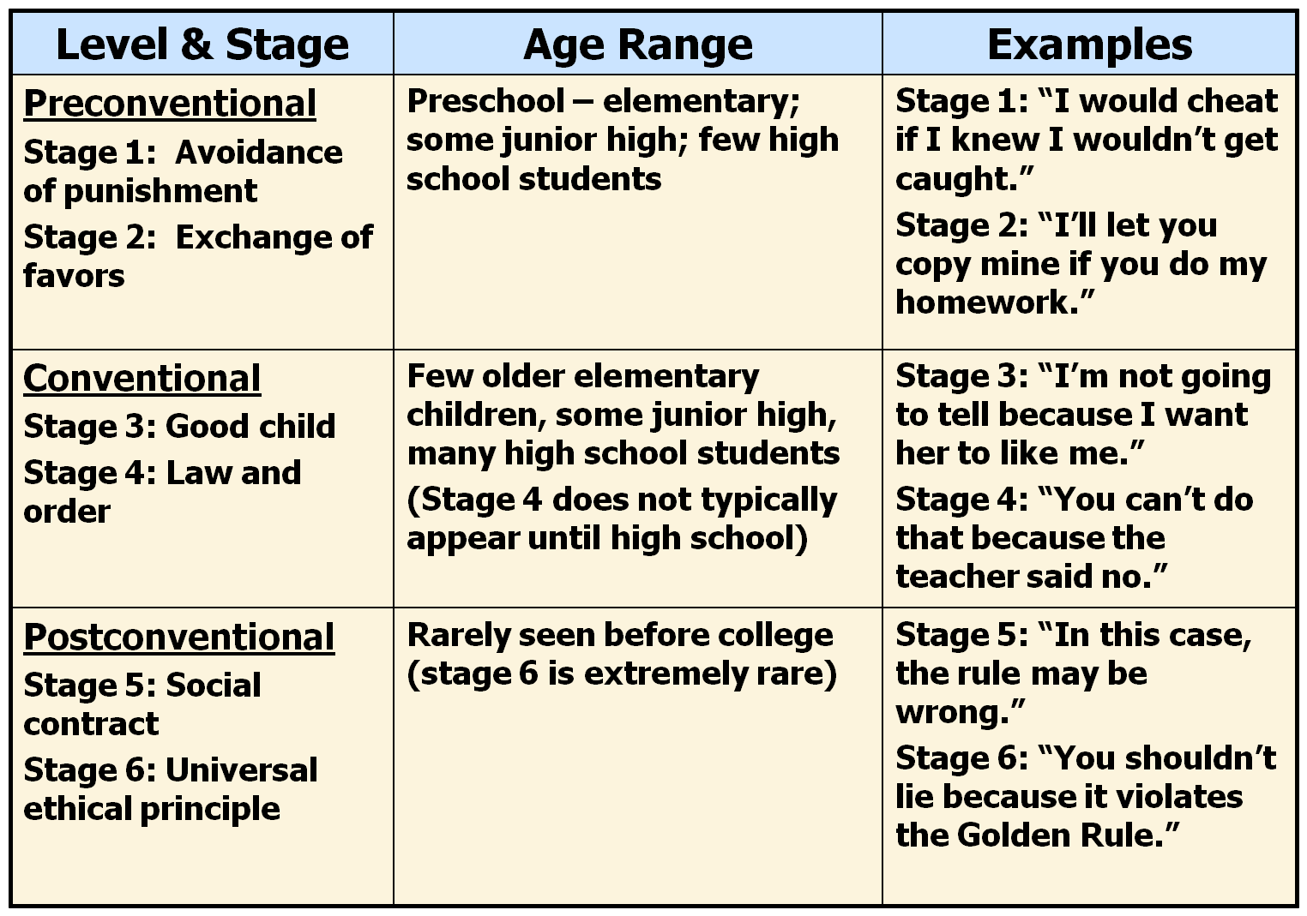
Moral Development
This depends on many factors that play into an adolescent’s life.
Kohlberg believes that moral development depends on one’s ability to think abstractly. However, the ability to think abstractly doesn’t mean high morals will develop
pg 103-104

Slide 15
Identity Development
Erikson believes that the establishment of identity is the key to adolescent behavior
Adolescents worry about their identities. Factors that play into the adolescent identity crisis:
Physiological Changes
Cognitive Development
Awakening Sex Drive
Adolescents are looking toward the future and realize that they must make decisions they want to be unique yet they want to fit in too.
Who am I?
To answer this, adolescents must look at their:
Needs
Abilities
Talents
Interests
Background
Culture
Peer demands
Etc.
Adolescents who are able to answer these questions and face realities fare better than their peers who refuse to do so
pg 104-106

Slide 16
Marcia’s view of Identity Crisis
Adolescents must begin to make commitments on matters of
Occupation
Religion
Political Orientation
pg 106

Slide 17
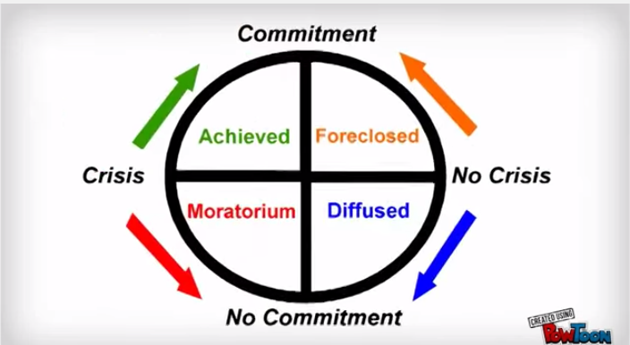
He divides adolescents into four categories to explain the dilemma
 | Exploring Identity Issues | Not Exploring Identity Issues YET
Decisions already made | Identity Achievement – they have thought it through, and committed to their decisions | Identity Foreclosure – they made their commitments based on the suggestions of others, not what they think
Decisions not yet made | Identity Moratorium – they are considering the issues, but haven’t made commitments | Identity confused or diffused – they haven’t given any serious thought to matters and have no clear sense of identity
pg 107

Slide 18
Social Learning View
Peterson – identity crisis isn’t normal, it’s impacted by external changes in environment/living situations
Bandura - We continue to develop during our whole life so it is all one continuous process of interaction with others – known as the Social Learning Theory
pg 107-108

Slide 19
Personality Development Summary
It involves many things
How a person develops a sense of self or identity
How that person develops relationships with others
The skills used in social interactions
End of Section 2

Slide 20
Terms page 109
Section 3 Objectives
Clique
Conformity
Anorexia nervosa
Bulimia nervosa
Describe the role of family and peers during adolescence
Discuss difficulties that some adolescents encounter

Slide 21
Social Development
The Role of the Family
Pre-1970’s: Husband worked, mom stayed home. Low divorce rate
Post-1970’s: More than half of all marriages end in divorce and both mom and dad work outside the home.
pg 109-110

Slide 22
The main thing adolescents have to deal with is changing their role in the family. They are trying to establish more independence, but it can be confusing for parents and kids.
Parents can be reluctant to let the kid grow up. They fear giving them extra responsibilities
Kids can be worried about messing up
The family situation can create extra problems as well.
Divorce can put more responsibility on the kid than they may be ready for
Overprotective/overly controlling parents may create a rebellious teen
pg 109-110

Slide 23
The Role of Peers
Adolescents use their friendships to help them to define themselves
Middle and high schools contain well-defined groups. Crossing from one group to another is difficult.
Younger ages the groups are defined by gender, sexes mix as the kids get older.
What determines which group kids choose?
Personal characteristics
Looks
Personality
Athletic Ability
pg 110-112

Slide 24
Cliques are important because they
Provide a means for personal definition
Help one achieve self-confidence
Help to develop a sense of independence
Help to clarify values
Allow one to experiment with new roles
Conformity is the glue that holds the clique together – this can be good or bad.
Sometimes the influences are
Peers set the standards on fashion, taste in music, and school related matters
Parents tend to still hold influence over marriage, religion, and educational plans
pg 110-112

Slide 25
Difficulties during adolescence
Invulnerability/lack of ability to recognize consequences
Running away
Teen pregnancies
Alcohol and drug abuse
Underachievement at school
Usually the above are a sign of more severe problems underneath
pg 112-115

Slide 26
Depression – Teen suicide has tripled in the past 50 years
What triggers teen depression?
#1 Cause: Loss of a loved one from:
Separation
Family Relocation
Divorce
Death
Teens need to be able to express their grief, guilt, panic, and anger in a healthy manner to avoid this depression.
pg 113-115

Slide 27
Adults usually look sad. Teens may appear extremely angry. They may take part in rebellious behavior:
Truancy
Running away
Drinking
Using drugs
Being sexually promiscuous
Anorexia and Bulimia Nervosa are both signs of depression in teens
End of Section 3

Slide 28
Terms page 116
Section 4 Objectives
Gender identity
Gender role
Gender stereotype
Androgynous
Gender schema
Explain the difference between gender identity and gender role.
Describe gender differences in personality and cognitive

Slide 29
Gender Roles and Differences
Gender identity – biological
Gender role – is how one acts based on what society expects because of your sex
These roles vary from society to society
Gender Stereotypes in our society are beginning to die down because of more androgynous role acceptances
pg 117-118

Slide 30
Gender differences in personality
Aggression
Males are more physically aggressive
Females are more verbally aggressive
Males have lower levels of serotonin than females. Serotonin is what helps control aggression.
Communication
Males are more talkative than females and interrupt females more
Females use more
Hedges like “kind of” and “you know”
Disclaimers like “I may be wrong” and “I’m not sure”
Tag questions at the end of sentences, like “okay?”
pg 118-119

Slide 31
Gender differences in cognitive abilities
Basically, there is no difference in cognitive abilities
Origins of gender differences
Biological Theory – anatomy, hormones, and brain organization differs
Psychoanalytical Theory – Freud says between the ages of 3 and 5 kids begin to identify with the same sex parent and the roles are then set
pg 119-120

Slide 32
Social Learning Theory – children learn gender roles by observing and imitating their role models (Parents, etc)
Cognitive-Developmental Theory – children learn gender roles by interacting with their environment and thinking about those experiences
Experiences cause kids to create gender schemas which help them to organize how they are suppose to act as male or female.
pg 121

Slide 33
Changing Gender Roles
More women in the workforce
More women in leadership positions
More involved dads
A slight trend in the mom working and the dad staying home to raise the kids.
pg 122

